Slide 1
Susi
Future Mental Care Innovation Team of Tsinghua University

Slide 2
Prototype Today
Input your feeling by simply use joy sticker to select and press to confirm
Hold RECORD button to record your thought, feeling, or anything.
The program will then analysis the recording using NLP to generate text.
You can review the emotion trending, pie chart and words frequency anytime.
Even edit and share part of your data with doctor or closest friends.
Powered by Qt5 pygame gcloud D3-visulization reveal.js

Slide 3
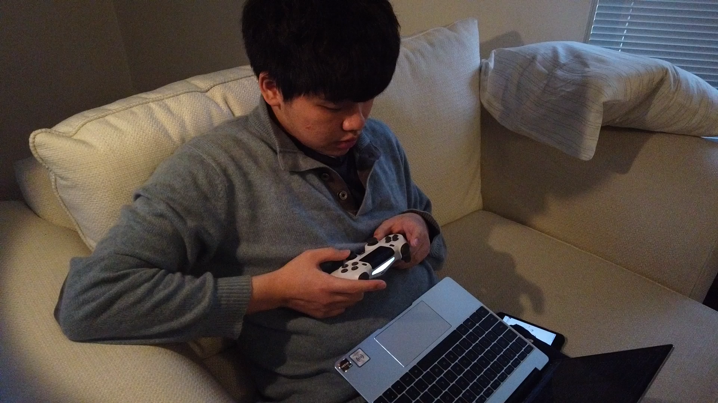

Slide 4
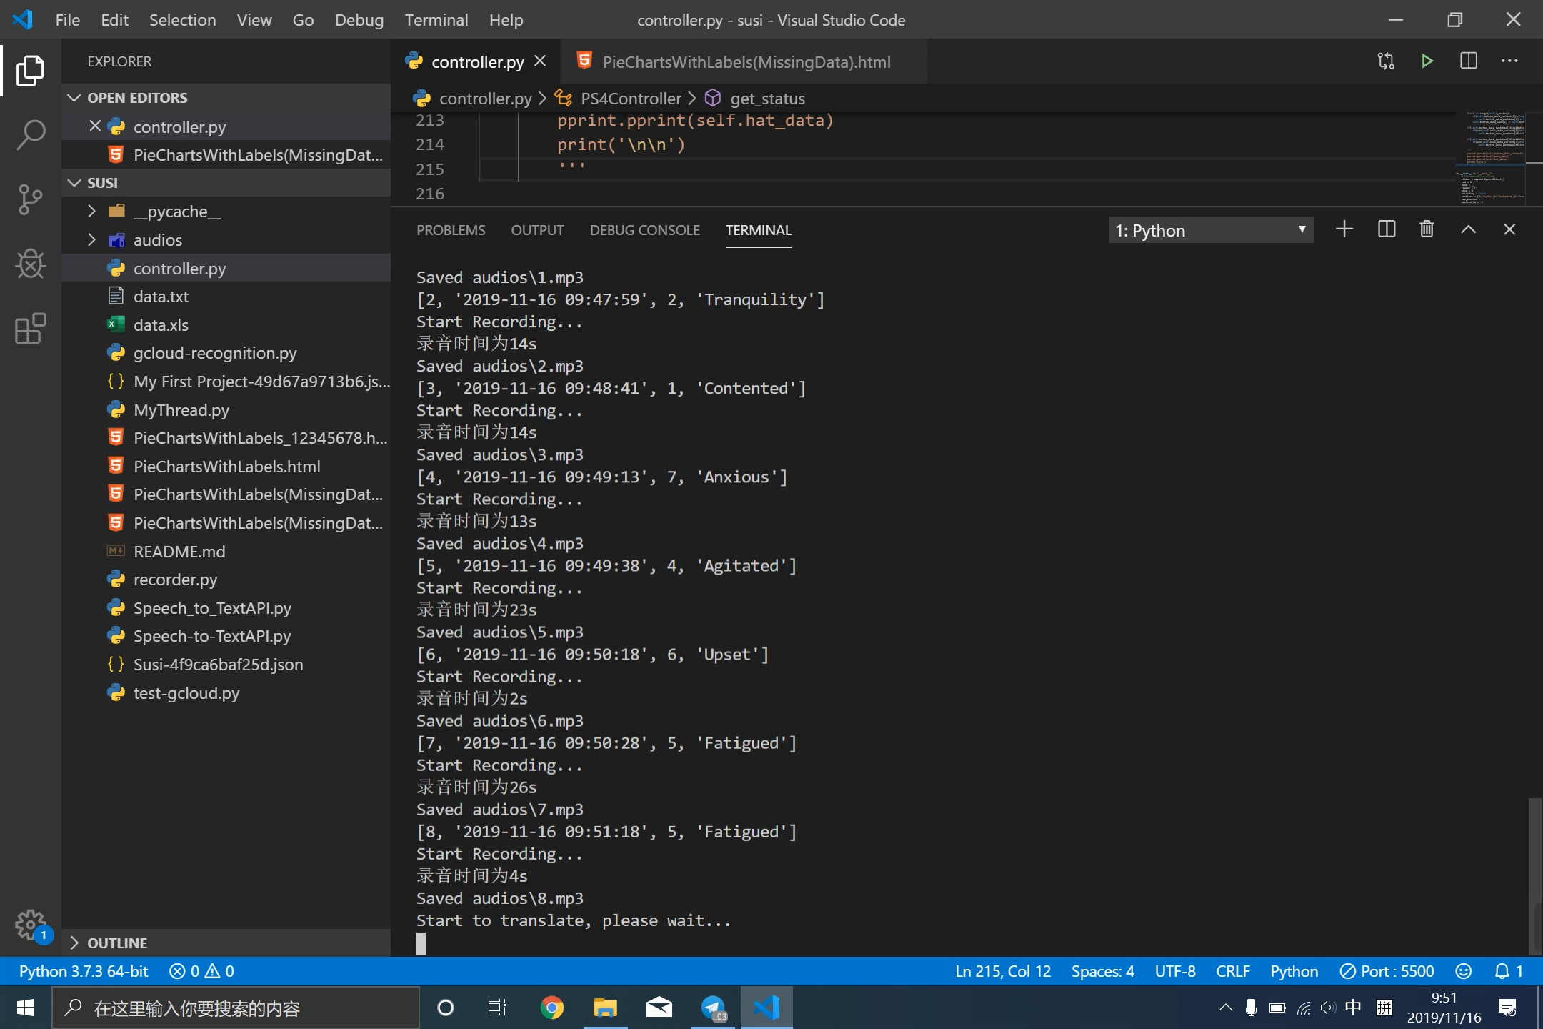

Slide 5
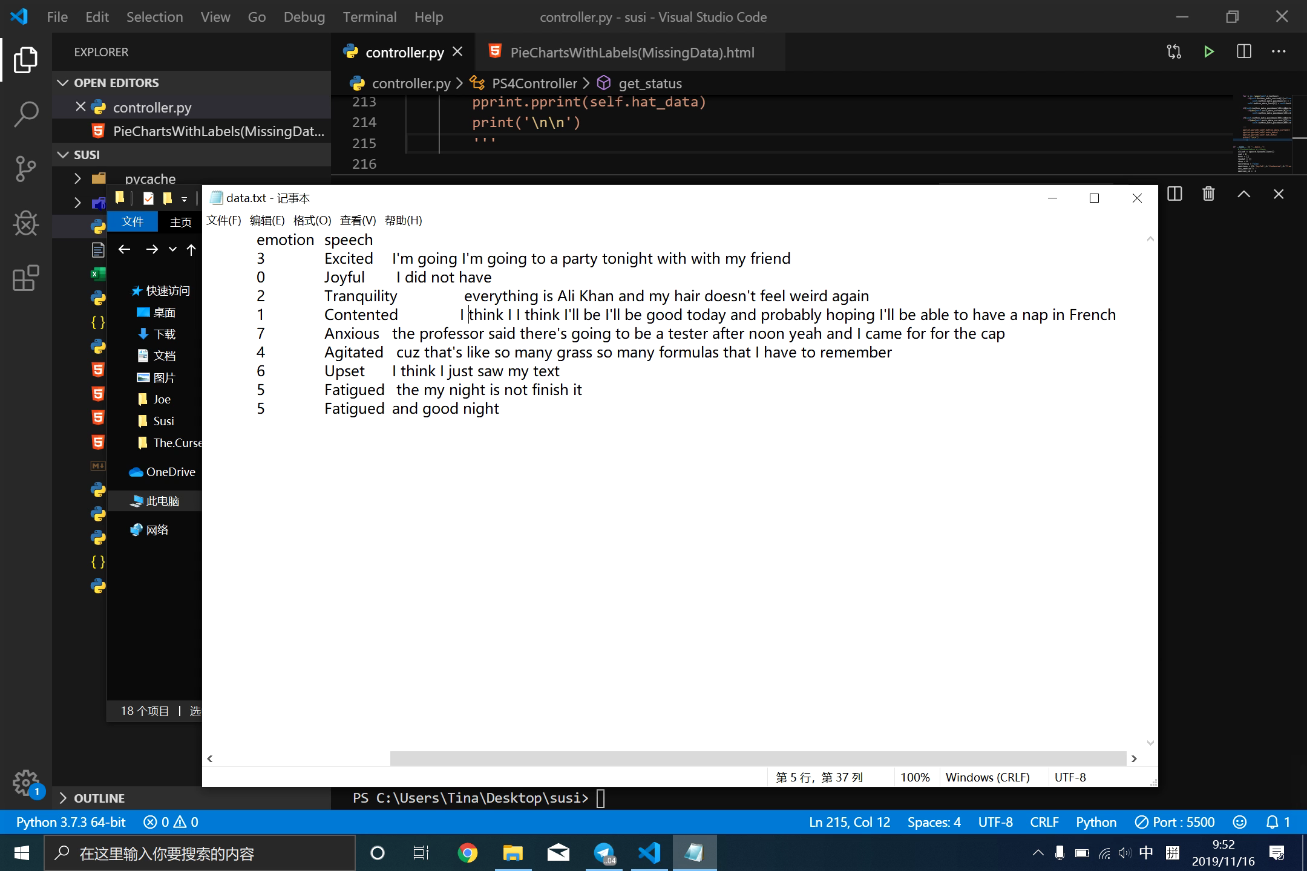

Slide 6
Hardware in the near future
Offline - Both hardware and software
User friendly appearance
NFC share
Mental support

Slide 7
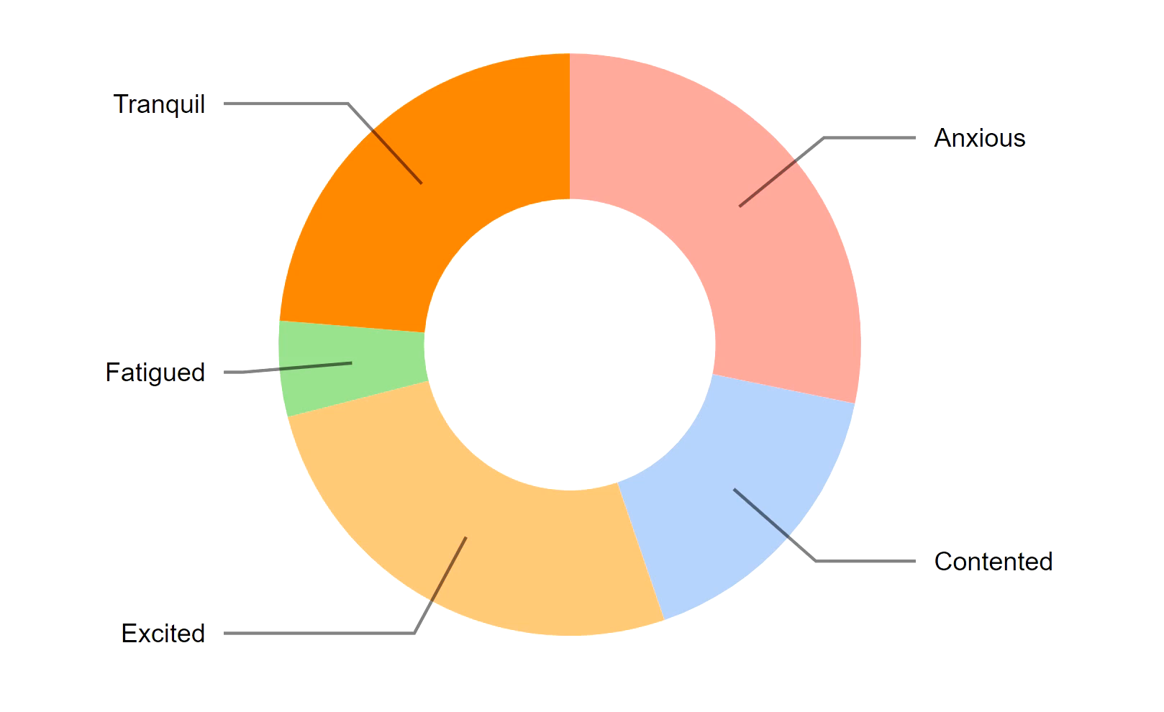

Slide 8
